Slide 1

AI Agents: The New Era of Artificial Intelligence

Slide 2
Agenda
Introduction
Large Language Models
Agents and AI Agents
Tools
Reasoning techniques
Multi-Agent systems
Use cases
Frameworks
Evaluation

Slide 3
Introduction
“ AI agents are the new digital workforce - working for and with us”
Notes:
Intelligent agents are considered by many to be the ultimate goal of AI
The new capabilities of foundation models make it finally possible to develop autonomous, intelligent agents to act as our assistants, coworkers, and coaches. They can help us create a website, gather data, plan a trip, do market research, manage a customer account, automate data entry, prepare us for interviews, interview our candidates, negotiate a deal, etc. The possibilities seem endless, and the potential economic value of these agents is enormous.

Slide 4
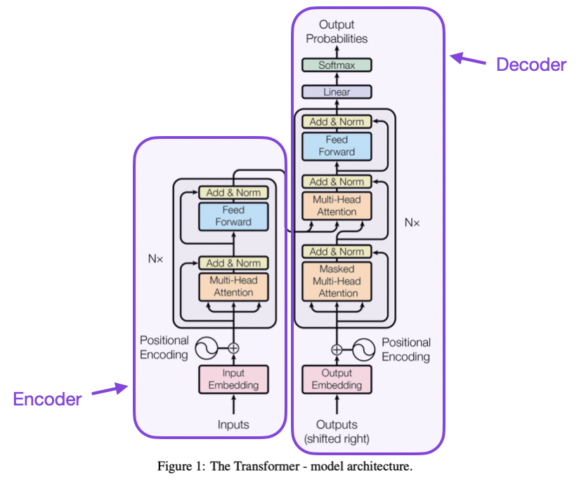

Large Language Models (LLMs)
The underlying principle of an LLM is simple yet highly effective: its objective is to predict the next token, given a sequence of previous tokens.
LLMs are said to be autoregressive, meaning that the output from one pass becomes the input for the next one.
Notes:
Gen AI: a type of artificial intelligence that can create new content, like text, images, music, or code, by learning patterns from existing data and then generating novel outputs based on those patterns
An LLM is a type of AI model that excels at understanding and generating human language. They are trained on vast amounts of text data, allowing them to learn patterns, structure, and even nuance in language. These models typically consist of many millions of parameters.
Most LLMs nowadays are built on the Transformer architecture—a deep learning architecture based on the “Attention” algorithm, that has gained significant interest since the release of BERT from Google in 2018.
A “token” is the unit of information an LLM works with. You can think of a “token” as if it was a “word”, but for efficiency reasons LLMs don’t use whole words.
LLMs are said to be autoregressive, meaning that the output from one pass becomes the input for the next one. This loop continues until the model predicts the next token to be the EOS token, at which point the model can stop.
Attention is all you need: A key aspect of the Transformer architecture is Attention. When predicting the next word, not every word in a sentence is equally important; words like “France” and “capital” in the sentence “The capital of France is …” carry the most meaning.

Slide 5
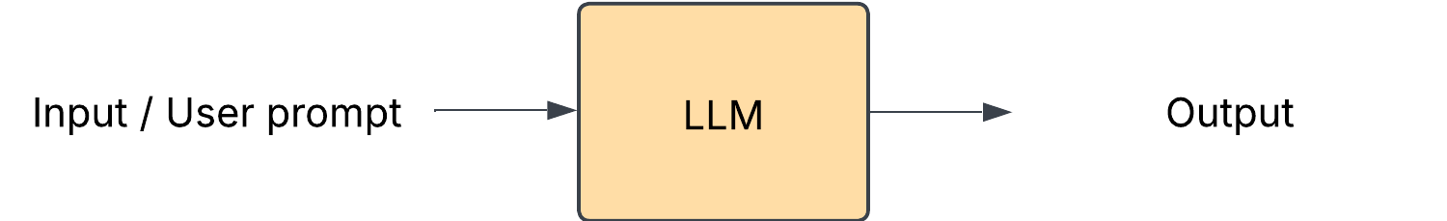
Large Language Models (LLMs)
Prompting the LLM is important
The Anatomy of an Effective Prompt:
1. Clarity and Specificity.
Be precise
Set Parameters
Provide Context:
2. Structure and Format
Use Clear Headers:
Break Down Tasks
Include Examples
3. Context Control
Role Definition
Audience Specification
Purpose Clarification
Notes:
Prompting is the art and science of crafting inputs that guide AI models to produce desired outputs. Think of it as having a conversation with a highly capable assistant – the clarity and structure of your requests directly influence the quality of responses you receive.
The Anatomy of an Effective Prompt
Creating effective prompts is essential for optimizing AI interactions, and it involves several key components:
1. Clarity and Specificity.
Be precise: Do not just say things like “write about dogs”; instead, tell your writer exactly what you expect of him or her, such as “write an article of no less than 500 words on the training needs of German Shepherds.” This procedure clarifies the content pertinent to the instant requirement, thus helping the AI do the work.
Set Parameters: It is important to state your requirements for the format, the length of the output, and its tone and style. Doing so helps the AI better meet your expectations.
Provide Context: Adding concern context and providing additional information gives AI the rules for answering the question.
2. Structure and Format
Use Clear Headers: Break up complex instructions with sections and headers where possible. This makes it easier for the AI to comprehend what you want done and makes it more coherent.
Break Down Tasks: When making complex instructions, enumeration of the procedures or the parts also helps the AI in that none of such parts may be left out.
Include Examples: Forcing examples of desired outputs can also help solve misunderstandings and serve as a guide for the AI, enhancing the quality of the outcomes produced.
3. Context Control
Role Definition: Identify the viewpoint or the level of proficiency required in the output. For example, when a question is posed, phrasing the question in such a way as to the request for content from the viewpoint of ‘a veterinary expert’ forces the AI to respond to the query from that perspective.
Audience Specification: The AI can determine its audience, or who the output is for, whether beginners, professionals, or everyone in between, thus helping it choose how complex or simple the content should be.
Purpose Clarification: To elaborate on the effect defined by the type of output, such as a blog post, a presentation, or educational material, it’s useful to explain how it will be used, which also improves relevance and efficiency.

Slide 6
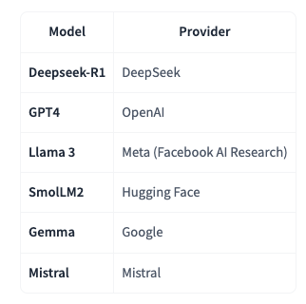
Large Language Models (LLMs)
How can I use LLMs?
Run Locally (if you have sufficient hardware).
Use a Cloud/API (e.g., via the Hugging Face Serverless Inference API).
Some well known LLMs:

Slide 7
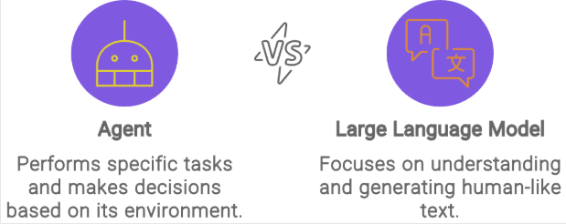
Taking LLMs one step further
LLMs:
Follow “request-and-respond” framework
are passive
are limited to responding and not reasoning
are capable of singular or linear tasks
Agents:
Orchestrate resources, use tools, collaborate with other agents
Are proactive
Carry tasks autonomously
LLMs are a key component of AI Agents, providing the foundation for understanding and generating human language.
Notes:
https://www.datacamp.com/tutorial/crew-ai
Why do we need agents? The example of interacting with a model and giving it feedback over time, that the user becomes a blocker
Unlike traditional generative AI models that follow a basic “request-and-respond” framework, AI agents go beyond by orchestrating resources, collaborating with other agents and utilizing tools such as large language models (LLMs), retrieval augmented generation (RAG), vector databases, APIs, frameworks, and high-level programming languages like Python.
Unlike LLMs, which are limited to responding, AI agents go beyond mere understanding — they take action. They are equipped to not only make decisions but also carry out tasks autonomously. For instance, while an LLM might help you brainstorm a travel itinerary, an AI agent will go a step further: booking your flights, comparing hotel prices, and scheduling your transportation without needing explicit commands for each step.
Agents can interpret user instructions, maintain context in conversations, define a plan and decide which tools to use.
When building applications with LLMs, we recommend finding the simplest solution possible, and only increasing complexity when needed. This might mean not building agentic systems at all. Agentic systems often trade latency and cost for better task performance, and you should consider when this tradeoff makes sense.
When to use agents: Agents can be used for open-ended problems where it’s difficult or impossible to predict the required number of steps, and where you can’t hardcode a fixed path. The LLM will potentially operate for many turns, and you must have some level of trust in its decision-making. Agents' autonomy makes them ideal for scaling tasks in trusted environments.

Slide 8
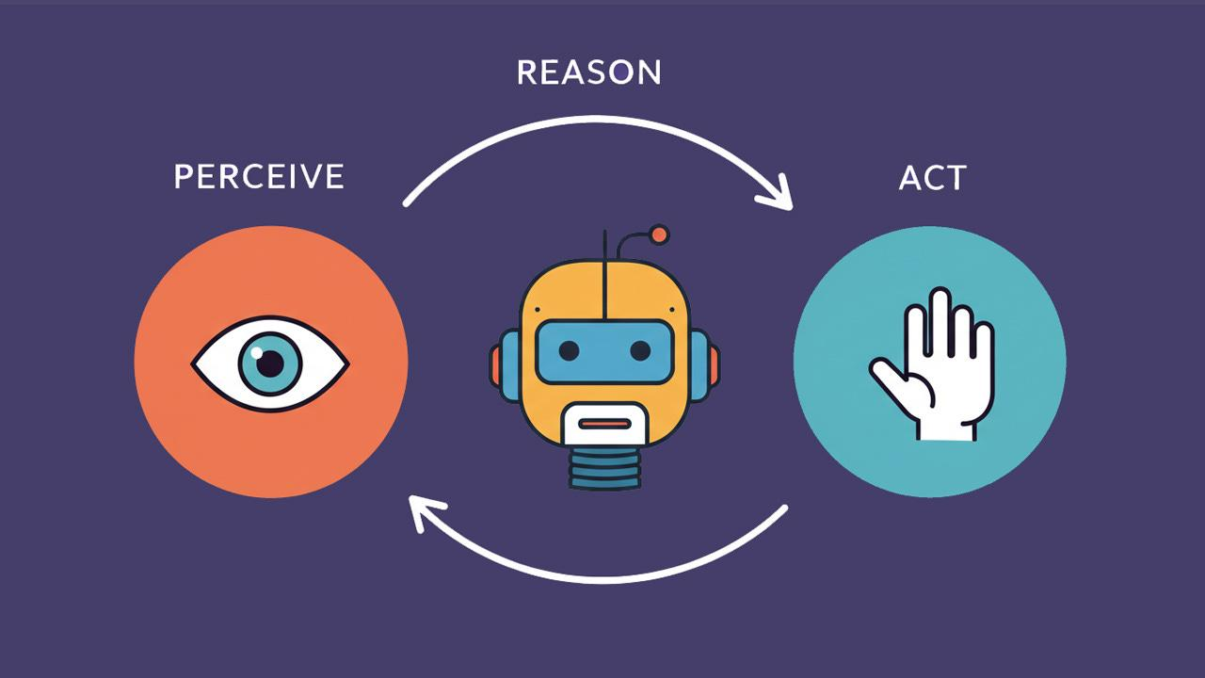
Agents
An agent is anything that can perceive its environment and act upon that environment
Autonomous AI agents require little to no human intervention to complete their specific tasks.
There are single agent, multi-agent and hybrid agentic architectures
Notes:
An agent is anything that can perceive its environment and act upon that environment. Artificial Intelligence: A Modern Approach (1995) defines an agent as anything that can be viewed as perceiving its environment through sensors and acting upon that environment through actuators.
Agents vs workflows
Workflows are systems where LLMs and tools are orchestrated through predefined code paths.
Agents, on the other hand, are systems where LLMs dynamically direct their own processes and tool usage, maintaining control over how they accomplish tasks.
Agentic architecture enables AI agents to act with a degree of autonomy and make decisions based on goals without the constant need for human input.³

Slide 9
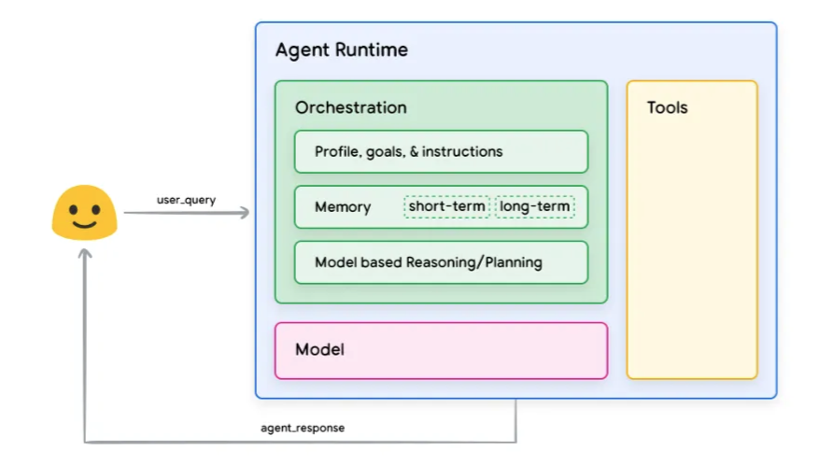
AI Agents
https://medium.com/@aleixlopez/introduction-to-ai-agents-62a790d0bc22
Each Agent needs an AI Model at its core, and that LLMs are the most common type of AI models for this purpose.
Notes:
Step-By-Step Process
Step 1. User or Machine Request
A user, or even another agent or system, initiates the agent’s workflow by requesting an analysis of sales data and a visual representation. The agent processes this input and decomposes it into actionable steps.
Step 2. The LLM: Understanding the Task
The LLM acts as the brain of the AI agent. It interprets the user’s prompt to understand the task requirements, such as:
Retrieving data from database.
Performing data analysis.
Creating a visual graph.
The LLM determines:
What information it already has.
What additional data or tools it needs.
A step-by-step plan to fulfill the task.
Step 3. Planning Module: Task Breakdown
The planning module divides the task into specific actions:
Fetch: Retrieve the latest sales data from the company database.
Analyze: Apply appropriate algorithms to identify trends and insights.
Visualize: Generate a graph to present the results.
Step 4. Memory Module: Providing Context
The memory module ensures context is preserved for efficient task execution:
Short-term memory: Tracks the context of the current workflow, such as similar tasks requested last quarter, to streamline the process.
Long-term memory: Retains historical knowledge, like the database location or preferred analysis methods, enabling deeper contextual understanding.
Step 5. Tool Integration: Performing the Task
The agent core orchestrates external tools to complete each step:
APIs: Retrieve raw sales data.
Machine learning algorithms: Analyze data for trends and patterns.
Code interpreter: Generates the graph based on the analysis results.
Step 6. Reasoning and Reflection: Improving Outcomes
Throughout the process, the agent applies reasoning to refine its workflow and enhance accuracy. This includes:
Evaluating the effectiveness of each action.
Ensuring efficient use of tools and resources.
Learning from user feedback to enhance future tasks.
For example, if the generated graph needs refinement, the agent adapts its approach to deliver better results in subsequent workflows.

Slide 10
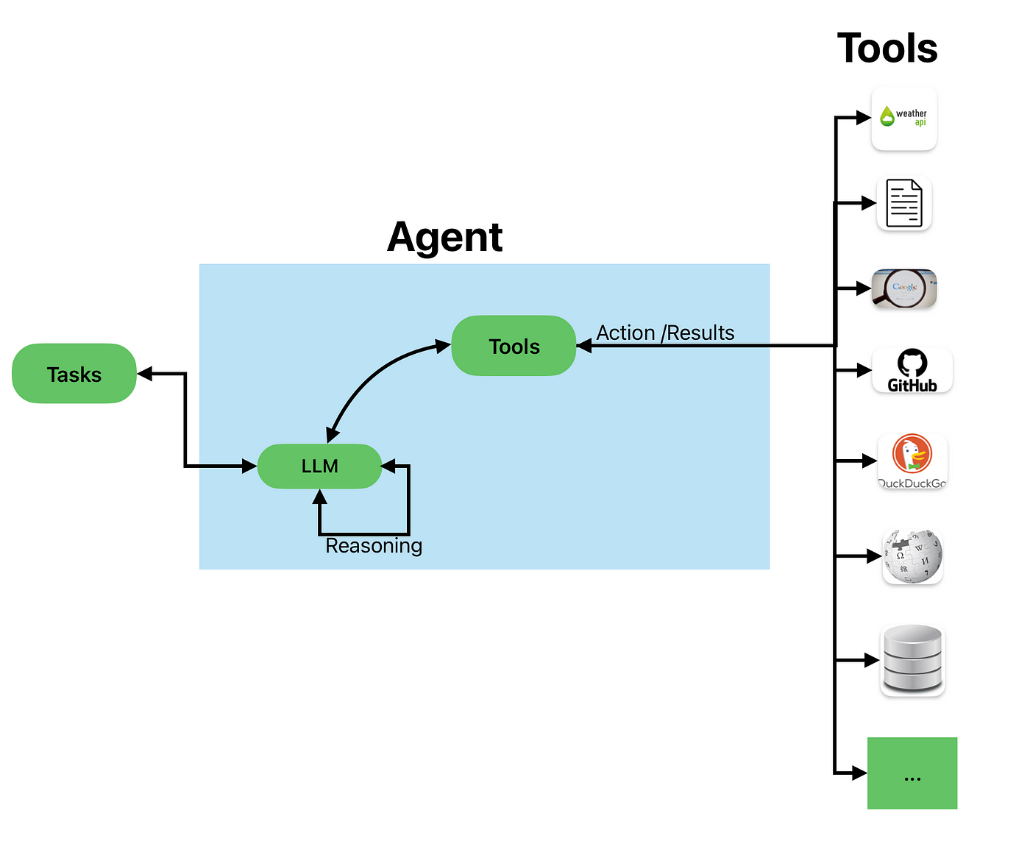
Tools
Tools allow the agent to connect with the external world.
A tool usually as simple as a function definition or an API call
def send_message_to(recipient, message):
"""Useful to send an e-mail message to a recipient"""
...
The LLM generates code to run the tool when it needs to, and thus fulfill the desired task.
send_message_to("Manager", "Can we postpone today's meeting?")
The tool should fulfill a clear objective.
https://medium.com/@Shamimw/understanding-langchain-tools-and-agents-a-guide-to-building-smart-ai-applications-e81d200b3c12
Notes:
An Agent can perform any task we implement via Tools to complete Actions.
For example, if I write an Agent to act as my personal assistant (like Siri) on my computer, and I ask it to “send an email to my Manager asking to delay today’s meeting”, I can give it some code to send emails. This will be a new Tool the Agent can use whenever it needs to send an email. We can write it in Python:
The design of the Tools is very important and has a great impact on the quality of your Agent. Some tasks will require very specific Tools to be crafted, while others may be solved with general purpose tools like “web_search”.
Note that Actions are not the same as Tools. An Action, for instance, can involve the use of multiple Tools to complete.
Tool examples: Web Search, Retrieval, Image generation. For instance, if you need to perform arithmetic, giving a calculator tool to your LLM will provide better results than relying on the native capabilities of the model. Need a good tool that complements the power of your LLM

Slide 11
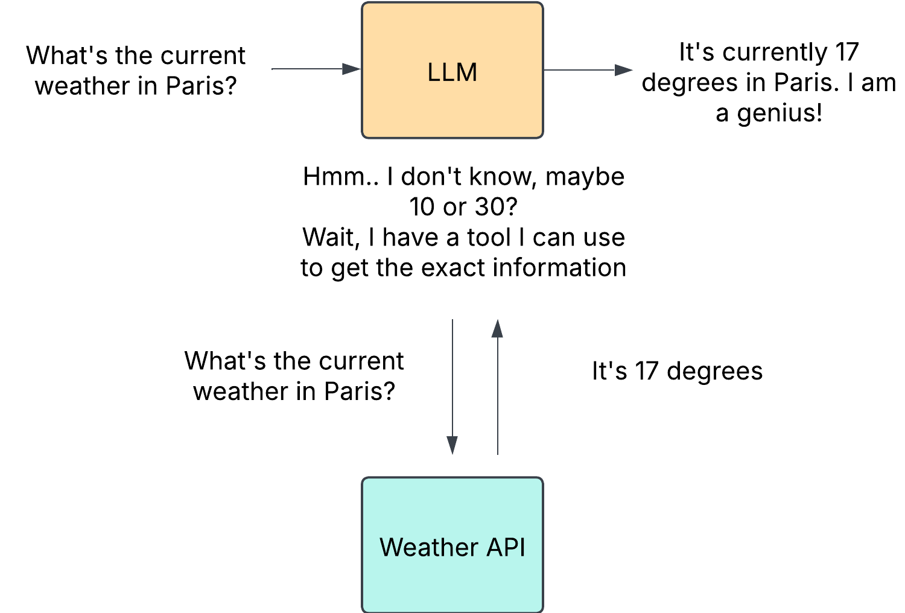
Tools
How do tools work?
In a nutshell, it’s teaching the LLM about the existence of tools, and ask the model to generate text that will invoke tools when it needs to.
Notes:
https://medium.com/@Shamimw/understanding-langchain-tools-and-agents-a-guide-to-building-smart-ai-applications-e81d200b3c12
LLMs, as we saw, can only receive text inputs and generate text outputs. They have no way to call tools on their own.
What we mean when we talk about providing tools to an Agent, is that we teach the LLM about the existence of tools, and ask the model to generate text that will invoke tools when it needs to.
For example, if we provide a tool to check the weather at a location from the Internet, and then ask the LLM about the weather in Paris, the LLM will recognize that question as a relevant opportunity to use the “weather” tool we taught it about.
The LLM will generate text, in the form of code, to invoke that tool. It is the responsibility of the Agent to parse the LLM’s output, recognize that a tool call is required, and invoke the tool on the LLM’s behalf. The output from the tool will then be sent back to the LLM, which will compose its final response for the user.

Slide 12
Tools
AI Agents frameworks nowadays come with a variety of tools that you can use. However, you can always create your own custom tools
Ways to inform the LLM about the tool:
In prompting
Json configuration
Python decorators
What makes a great tool?
Versatile
Fault tolerant
Caching
Notes:
What makes a tool great?
Versatile: accepts different types of requests
Fault tolerant: fail gracefully, self heal, how to handle errors and exceptions. Instead of stopping the crew, return the error to LLM and let it handle it, maybe it provided the wrong input format
Caching: prevents unnecessary requests from happening, saves tool with set of argos (across agents, indep from agent if same tool and same argos) saves exec time, stay within rate limits (api calls)

Slide 13

Reasoning techniques
Reason & Act (ReAct)
Chain-of-Thought (CoT)
Tree-of-thoughts (ToT)
Notes:
Give weather example
Agents can utilize any of the above reasoning techniques. Basically, what these frameworks will do is to force the LM to think step by step, carefully considering the available information and taking the most appropriate actions based on that reasoning.

Slide 14
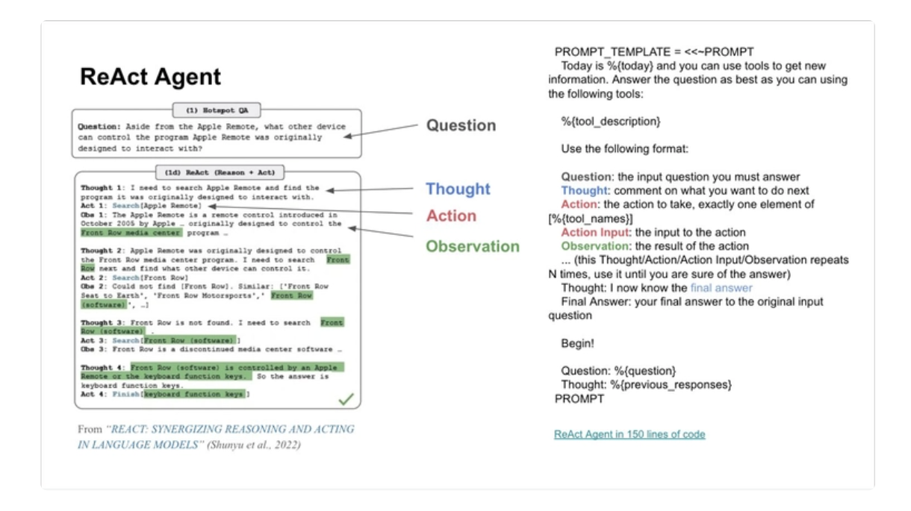
ReAct - Reason + Act
A key method is the ReAct approach, which is the concatenation of “Reasoning” (Think) with “Acting” (Act).
ReAct is a simple prompting technique that appends “Let’s think step by step” before letting the LLM decode the next tokens.
Notes:
What we see in this example:
Agents iterate through a loop until the objective is fulfilled:
Alfred’s process is cyclical. It starts with a thought, then acts by calling a tool, and finally observes the outcome. If the observation had indicated an error or incomplete data, Alfred could have re-entered the cycle to correct its approach.
Tool Integration:
The ability to call a tool (like a weather API) enables Alfred to go beyond static knowledge and retrieve real-time data, an essential aspect of many AI Agents.
Dynamic Adaptation:
Each cycle allows the agent to incorporate fresh information (observations) into its reasoning (thought), ensuring that the final answer is well-informed and accurate.
This allows the model to consider sub-steps in more detail, which in general leads to less errors than trying to generate the final solution directly.

Slide 15
Multi-Agents system
When Do Single AI Agents Start to Fail?
Over time, as the tasks become more complex and the number of tools grow larger, the single-agent approach will start to be challenging.
We will notice effects when the agent starts to misbehave, which can result from:
Too many tools
Too much context
Too many mistakes
Too complex tasks
Notes:
A single-agent approach can make sense at first (i.e., one AI agent that can do everything from navigating a browser to dealing with file operations). Over time though, as the tasks become more complex and the number of tools grow larger, our single-agent approach will start to be challenging.
When we start automating multiple distinct subtasks such as data extraction or report generation, it might be time to start separating responsibilities. By using multiple AI agents, where each agent focuses on its own domain and toolkits, we can enhance the clarity and quality of our solution. Not only does this allow the agent to become more effective, but it also eases the development of the agents themselves.
Too many tools: The agent gets confused on which tools to use and/or when. Large number of tools with different scopes: If your agent handles file I/O, database queries, data analysis, and visualizations, it may be too broad. Splitting agents by specific domains helps simplify the context and reduce agent and developer confusion.
Also that would increase the context window. Too much context: The agent’s increasingly large context windows contain too many tools.
2. Performance and reliability issues When a single agent becomes too large or complex, it may start to choose the wrong tools or fail tasks due to overly broad contexts. Too many mistakes: The agent starts to produce suboptimal or incorrect results due to overly broad responsibilities.
3. Complexity
Having distinct agents keeps responsibilities focused and manageable. For example, a “DatabaseAgent” that only queries data is simpler to read and write (as well as more reliable) than a general-purpose single agent doing it all.

Slide 16
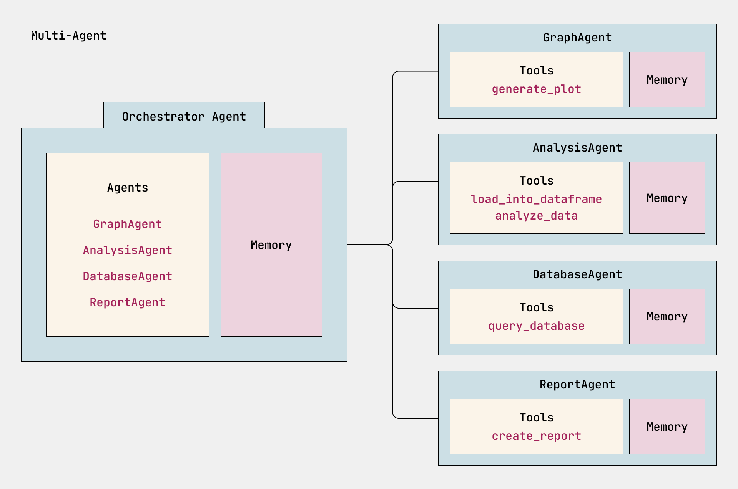
Multi-Agents system
Benefits:
Increased capabilities
Enhanced specialization
Scalability
Challenges
Cost
Debugging complexity
Clear boundaries
Overhead
Notes:
An extra Agent here which is an orchestrator agent
Built on top of one agent. One agent can task another agent with another task
You can have each agent customized to a single thing and do it well, one researcher and another writer for example
You can use different LLMs for different agents
=> better results
Benefits:
Increased capabilities: Dividing workloads between multiple agents allows AI to find solutions to increasing complex problems.
Enhanced specialization: With each agent tuned to a specific domain, tasks become more focused and consistent.
Scalability: Multi-agent AI systems can easily add new agents as the need arises, avoiding overloading a single agent.
Of course, some of these benefits bring added responsibilities that practitioners should be aware of.
Challenges of Multi-Agent Systems
As for the challenges of orchestrating multiple agents, the following are worth keeping top of mind:
Cost: As more agents are involved and more LLM calls are created, the cost associated with completing the goal will increase.
Debugging complexity: As multiple agents are incorporated, knowing where things are breaking can become difficult.
Clear boundaries: As more tools are added to more agents, knowing when to increase or decrease one agent over the other can become muddied.
Overhead: The developer is ultimately responsible for identifying where an agent would work best.

Slide 17
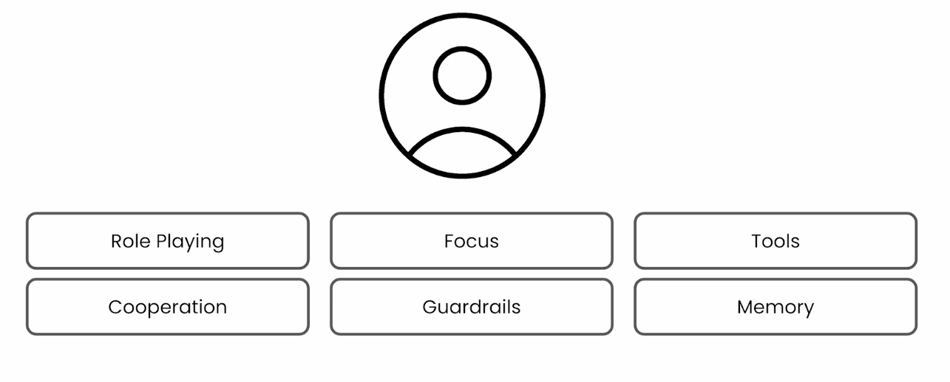
What makes Agents great
Notes:
Role Playing: use specific keywords in the role, backstory, goals
Focus: if you mix things too much, your models can lose important information -> hallucination
Tools: less is more, too many tools and they’ll have a hard time choosing
Cooeperation
Guardrails: prevents agents from derailing, so that it doesn’t suck on a loop and using the same tool (especialaly with less capable small models) and avoid hallucinations
Memory: different types of memory and implementation: short term: during the crew and shared across agents (agent 1 have access to agent’s 2 memory thus learning from it), long term: stored in local DB, stays even after crew finishes, it would self-critic itself and use that knowledge to produce better future response, Entity memory

Slide 18
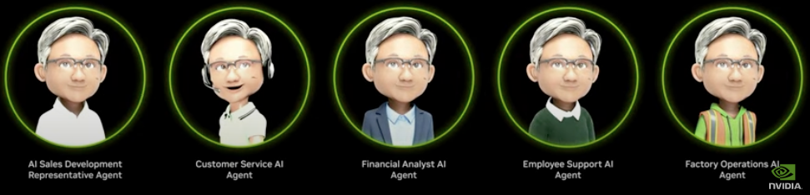
Use Cases
The new digital workforce
Personal Assistant
Customer service
Workflow optimization
Content Creation
Fraud detection / Security analyst
Notes:
Customer service:AI agents can provide 24-hour support while understanding natural language queries in both text and voice forms, resolving complex issues by taking action on behalf of the customer. Example: A call center operator or chatbot can automate workflow tasks such as connecting to internal systems like the CRM, checking to see if a customer request qualifies for a refund, or inputting data needed to start a return.
Workflow optimization :AI agents for specific applications can help streamline how efficient a human is at using that tool. For example, AI co-pilots can help a user understand all the features of an application and automate how those features are used or suggest how a person can best use that tool.
Agentic AI can help quickly create high-quality, personalized marketing content. Generative AI agents can save marketers an average of three hours per content piece, allowing them to focus on strategy and innovation. By streamlining content creation, businesses can stay competitive while improving customer engagement.

Slide 19

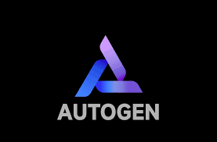


Frameworks
Agentic frameworks are the building blocks for developing, deploying and managing AI agents.
What to consider:
Complexity
Data privacy and security
Ease of use
Seamless integration
Performance and scalability
Popular frameworks:
AutoGen
Crew AI
LlamaIndex
LangChain
LangGraph
Notes:
The need for agent frameworks arises from the increasing complexity of AI applications, particularly those involving multiple agents working collaboratively to achieve a common goal.
Agentic frameworks are the building blocks for developing, deploying and managing AI agents. These software platforms have built-in features and functions that help streamline and speed up the process
Why use AI frameworks?
Orchestration and coordination
Managing these interactions and ensuring they work harmoniously becomes increasingly difficult. Agent frameworks offer a structured environment that allows for the orchestration of agent activities, defining their roles and responsibilities, and improving communication.
In multi-agent systems, an important aspect is the efficient allocation of tasks to the most suitable agents and managing shared resources effectively. Agent frameworks provide dynamic mechanisms for task allocation, resource negotiation, and conflict resolution.
Modularity and reusability
Agent frameworks promote a modular approach to AI development, where agents are designed and implemented as independent components. This modularity allows for better code organization and enables the reuse of agent modules across various projects, thus simplifying the development and maintenance of complex systems. With this component-based structure, AI developers can focus on individual agents without disrupting the larger system
Seamless integration
Evaluate agentic AI frameworks based on their compatibility with your existing tech stack. Check how well your choice of framework integrates with your current data sources, infrastructure and tools.
However:
These frameworks make it easy to get started by simplifying standard low-level tasks like calling LLMs, defining and parsing tools, and chaining calls together. However, they often create extra layers of abstraction that can obscure the underlying prompts ​​and responses, making them harder to debug. They can also make it tempting to add complexity when a simpler setup would suffice.

Slide 20
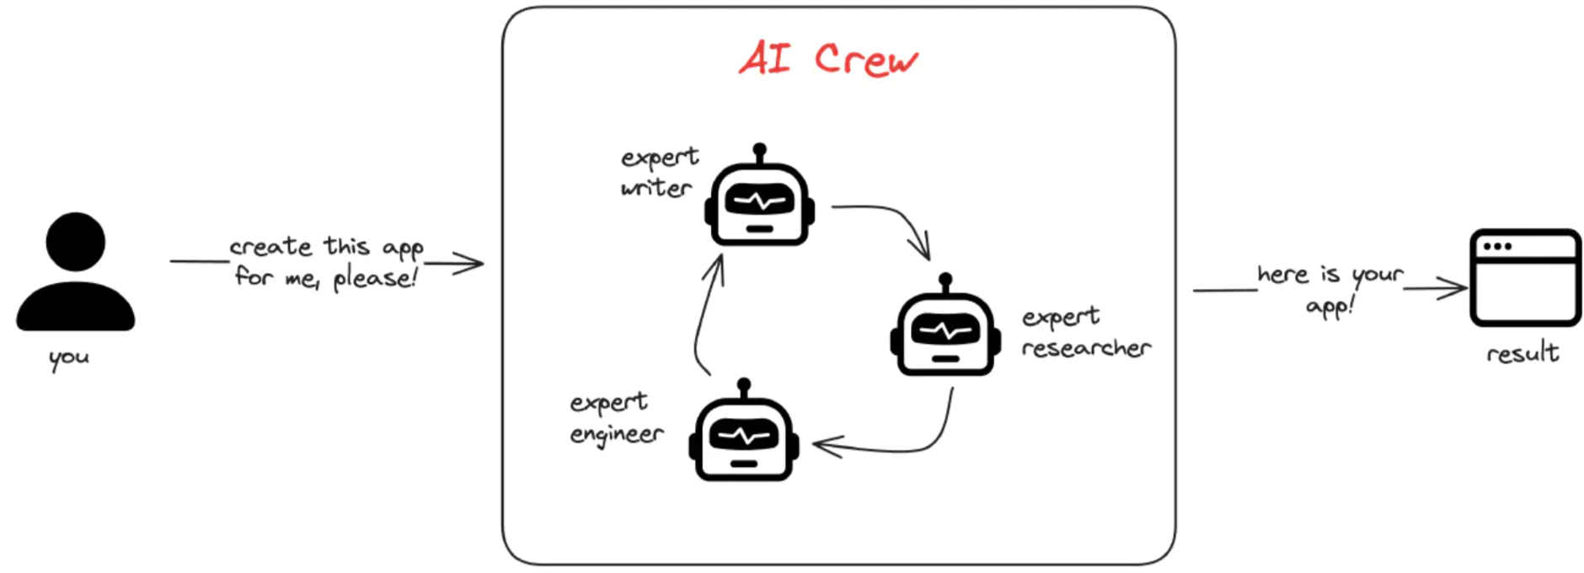
CrewAI
Agents in CrewAI are essentially ReAct agents coded with LangChain
Open Source Platform and a framework for building Agents
Breaks the concepts down to simple structures
Provides a pattern to put these systems together
Provides tools ready to use by the agent + provides a model to build custom tools
Offers a platform for production

Slide 21
Evaluation
To evaluate an AI Agent, it is important to have the ability to evaluate not only the agent's output but also the entire system that your AI Agent is operating in. This includes but is not limited to:
The initial model request.
The agent's ability to identify the intent of the user.
The agent's ability to identify the right tool to perform the task.
The tool's response to the agent's request.
The agent's ability to interpret the tool's response.
The user's feedback to the agent's response.
Notes:
Before, during, and after deploying AI Agents, having a proper system to evaluate your AI Agents is critical. This will ensure that your system is aligned with you and your users' goals.

Slide 22
The journey of AI Agents is just beginning … Stay tuned for more!
Thank you!

